Slide 1
Applied Data Science Capstone
A Place Like Home

Slide 2

Where do we move?
We know the neighborhoods in our city, but not in others.
When we move, we need at least two things:
It has to be affordable.
It has to have the character that we want.
We know the “spirit” of the neighborhoods in our city, but not in others.
Given a neighborhood we like and can afford in our city, we need to find one similar in the country we are moving to.

Slide 3
How to compare two neighborhoods?
Affordability
Mean rent rates.
Character
Similar types of venues.
Frequency of the types of venues.

Slide 4


Which are the cities?
New York
London

Slide 5
Where we get the data?
Venues:
Foursquare Developers – foursquare.com
Locations:
New York: NYC Open Data – data.cityofnewyork.us
London: Doogal.co.uk
Rent rates:
New York: Street Easy – streateasy.com
London: Valuation Office Agency – www.gov.uk

Slide 6
Analyzing the data
Total neighborhoods: 481.
London: 182 postcode districts.
New York: 299 neighoborhoods.
Total venues: 18,614.
London: 8,631 venues.
New York: 9,983 venues.
Types of venues: 483.
Radius of area calculated of neighborhood: 500 mts.

Slide 7
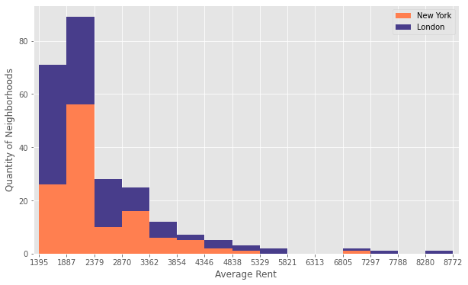
Rent profile of the two cities

Slide 8
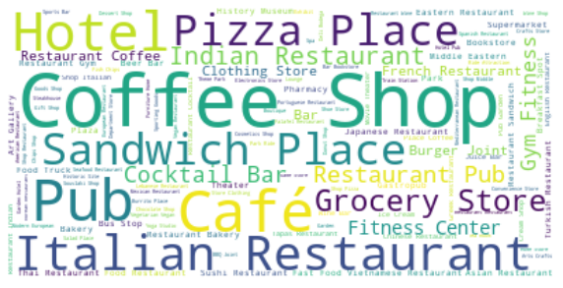
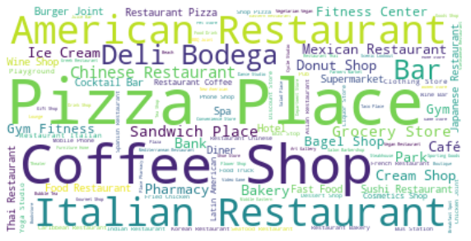
Venues per city
London
New York
New York

Slide 9
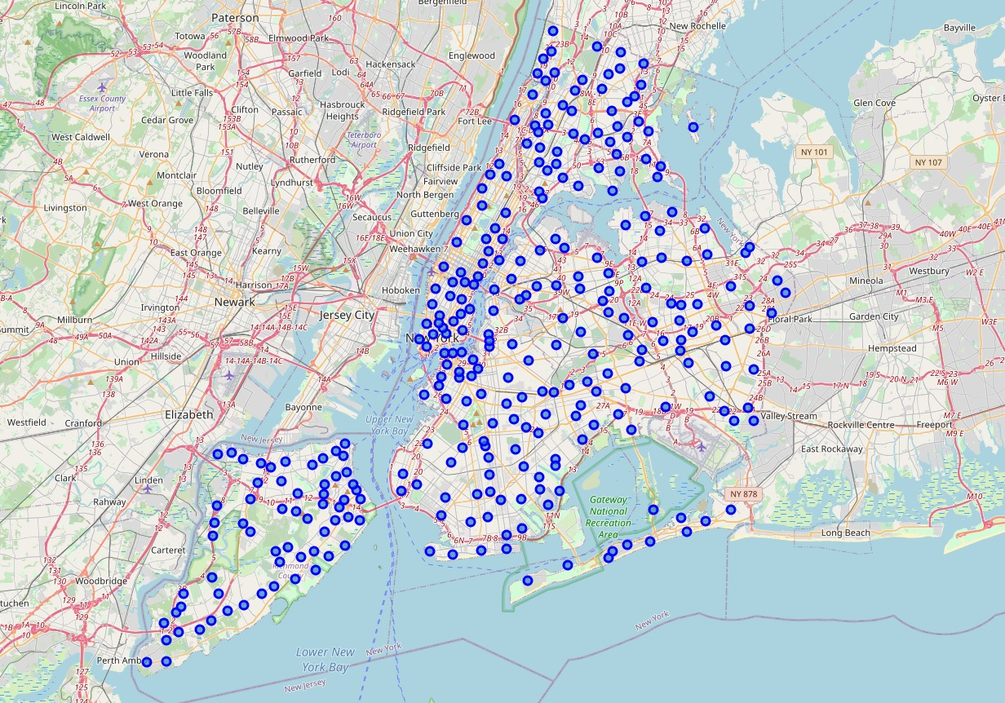
Neighborhoods of New York

Slide 10
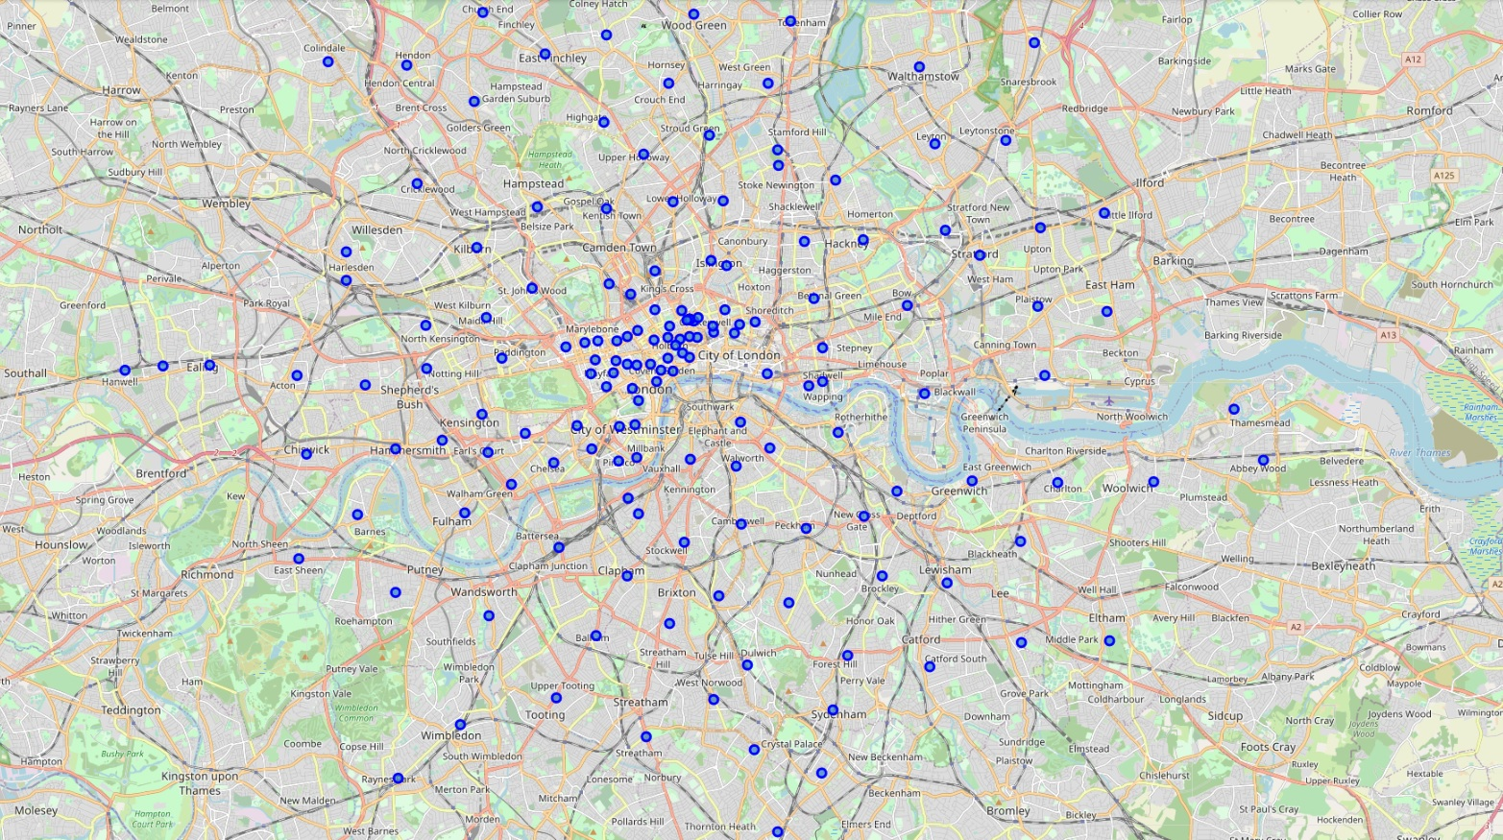
Neighborhoods of London

Slide 11
How to implement?
K-means clustering:
Segments data into clusters.
Data in clusters similar among each other, different to the rest.
Easy to represent visually.
Relatively efficient.
Good for medium to large sized databases.

Slide 12

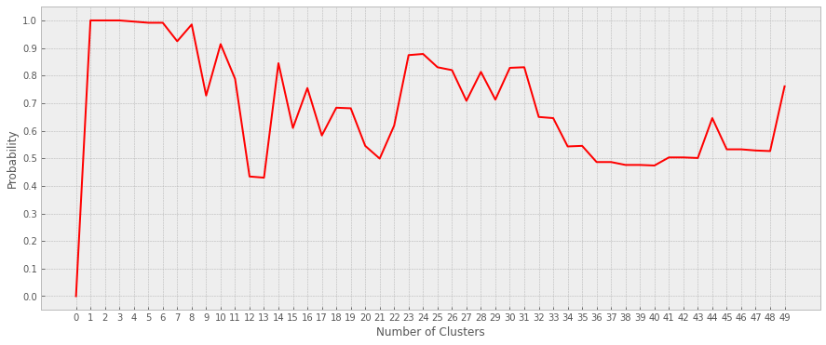
Probability of finding city by the value of K
Maximum: 24 clusters.

Slide 13
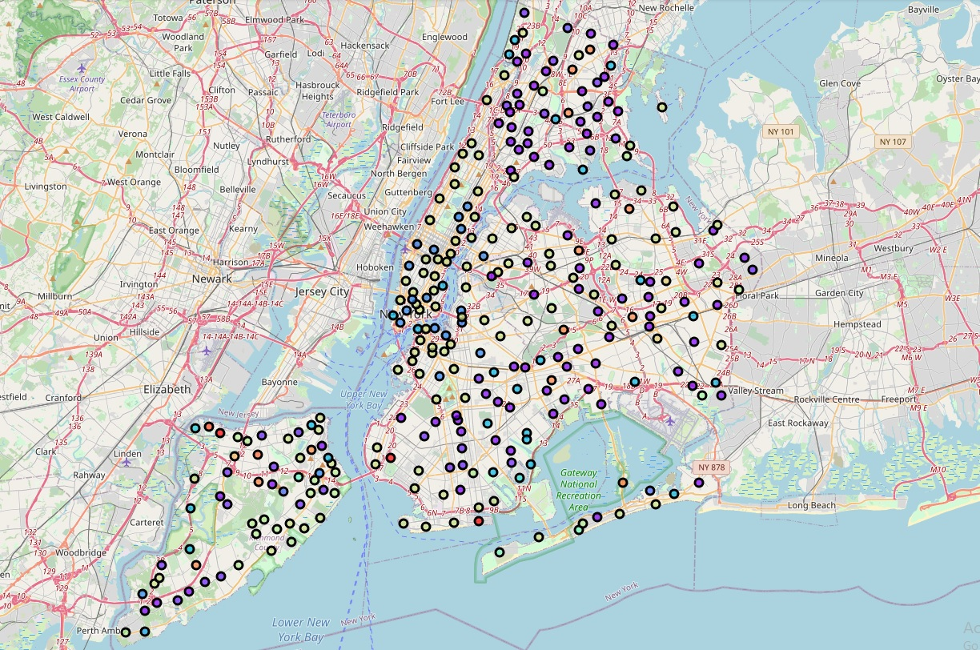
Clusters of New York

Slide 14
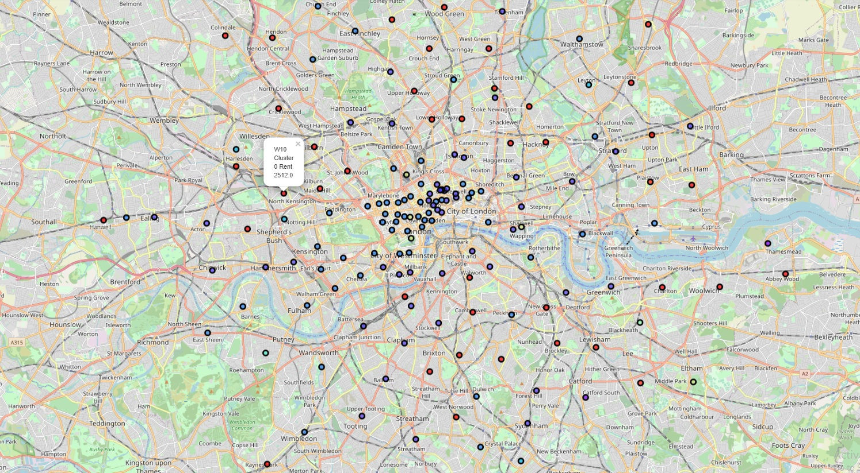
Cluster of London

Slide 15
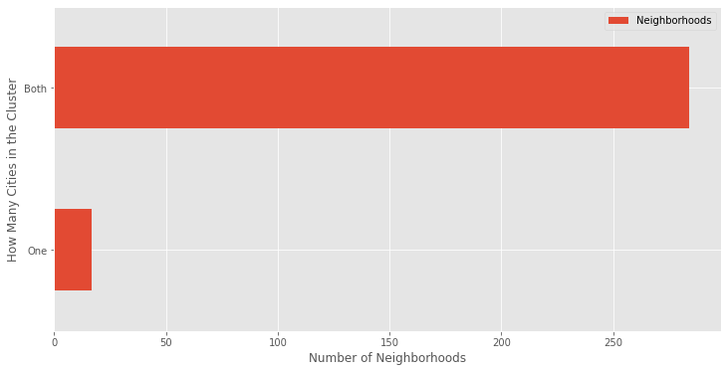
How many cities in one cluster?

Slide 16
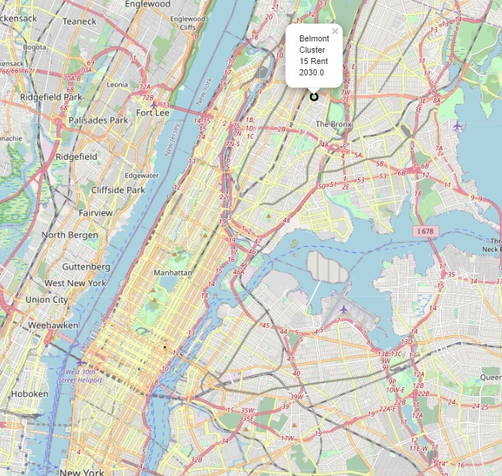
Example: Belmont, NYC

Slide 17
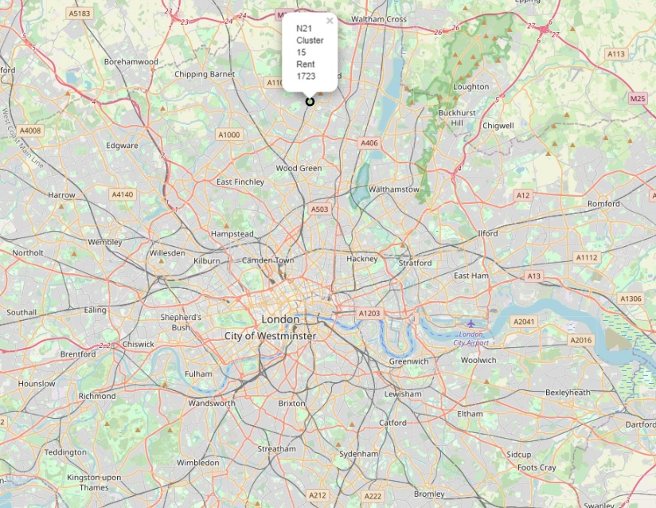
Example: Similar neighborhood

Slide 18
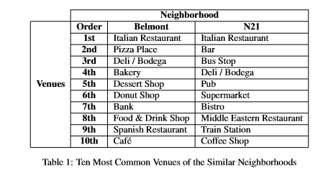
Example: Venue comparison

Slide 19
Conclusion
We can find comparable and affordable neighborhoods using clustering algorithms
It can be applied to many other fields besides real market.
Improvements could be made:
Better classification of venues.
Dynamic area of neighborhoods.
Use more complex clustering models.

